Slide 1
Db2- Table Partitioning
Speaker: SANJAY RANA
IBM Advanced Db2 Support
Time: 26th Spet 2023 at 3-4 pm IST
Place – (https://ibm.webex.com/meet/sanjay.rana)
© Copyright IBM Corporation 2009, 2020

Slide 2
Agenda Concepts
- Table partitions
- Benefits - Partition keys
- Roll-in (attach)
- Roll-out (detach) - Performance
© Copyright IBM Corporation 2009, 2020

Slide 3
Partitioned tables use a data organisation scheme in which table data is divided across multiple storage objects, called data partitions or ranges, according to values in one or more table partitioning key columns of the table.
A data partition or range is part of a table, containing a subset of rows of a table, and stored separately from other sets of rows. Data from a given table is partitioned into multiple data partitions or ranges based on the specifications provided in the PARTITION BY clause of the CREATE TABLE statement. These data partitions or ranges can be in different table spaces, in the same table space, or a combination of both. If a table is created using the PARTITION BY clause, the table is partitioned.
All of the table spaces specified must have the same page size, extent size, storage mechanism (DMS or SMS), and type (REGULAR or LARGE), and all of the table spaces must be in the same database partition group.
A partitioned table simplifies the rolling in and rolling out of table data and a partitioned table can contain vastly more data than an ordinary table. You can create a partitioned table with a maximum of 32,767 data partitions. Data partitions can be added to, attached to, and detached from a partitioned table, and you can store multiple data partition ranges from a table in one table space.
Indexes on a partitioned table can be partitioned or non-partitioned. Both non-partitioned and partitioned indexes can exist together on a single partitioned table.
Restrictions
Partitioned hierarchical or temporary tables, range-clustered tables, and partitioned views are not supported for use in partitioned tables.
Table Partitioning
© Copyright IBM Corporation 2009, 2020

Slide 4
Database Administrators and Applications Developers are confronted with increasingly demanding systems with:
VeryLargeTables–As the price of disk storage continues to decrease, the demand to store more information has increased.
High Availability – Many systems provide 24 x 7 access to data and are required to planned outages and scheduled maintenance as short as possible.
Scalability – Databases need to be handle growth in a way that system resources can be added to maintain performance in a cost effective manner.
Efficient access plans for complex queries – Application users expect to be able to perform analysis on large portions of very large tables with high performance characteristics.
Efficient Load (Roll-in and Roll-out) – Many applications need to add and remove large amounts of data on a periodic basis, possibly weekly or monthly, adding to existing tables in a manner that minimizes the time required to add the data and also minimises any loss of application access to the data.
Database Administrators have a number of tools and techniques available to address these requirements including:
• Database Partitioning
• Multi-Dimensional Clustering (MDC) tables
• UNION ALL views
From DB2 9 for Linux, UNIX and Windows, range-based table partitioning provides a significant new tool to this list.
Why Table Partitioning
© Copyright IBM Corporation 2009, 2020

Slide 5
Terminology
Three ways to spread data, and you can mix and match!
DISTRIBUTE BY HASH - currently in EEE/DPF
PARTITION BY RANGE – aka table partitioning
ORGANIZE BY DIMENSIONS – aka MDC
Node 1
Node 2
Node 3
Distribute
T1 Distributed across 3 database partitions
TS1
TS2
TS1
TS2
TS1
TS2
Partition
Jan
Feb
Jan
Feb
Jan
Feb
North
South
North
South
North
South
North
South
Organize
North
South
North
South
East
West
East
West
East
West
East
West
East
West
East
West
© Copyright IBM Corporation 2009, 2020

Slide 6
• Allows a single logical table to be broken up into multiple separate physical storage objects:
– Each corresponds to a partition of the table – Partition boundaries correspond to specified value ranges in a specified partition key
Main Benefits: – Allows for partition elimination during SQL processing – Allows for optimized roll-in / roll-out processing (for example, minimized logging) – Allows for divide and conquer management of huge tables
Table Partitioning: What is it and Why use it?
Without Partitioning
2022 - SALES DATA
With Table Partitioning
01-2022
SALES DATA
02-2022
SALES DATA
03-2022
SALES DATA
04-2022
SALES DATA
05-2022
SALES DATA
06-2022
SALES DATA
07-2022
SALES DATA
08-2022
SALES DATA
09-2022
SALES DATA
10-2022
SALES DATA
11-2022
SALES DATA
12-2022
SALES DATA
© Copyright IBM Corporation 2009, 2020

Slide 7
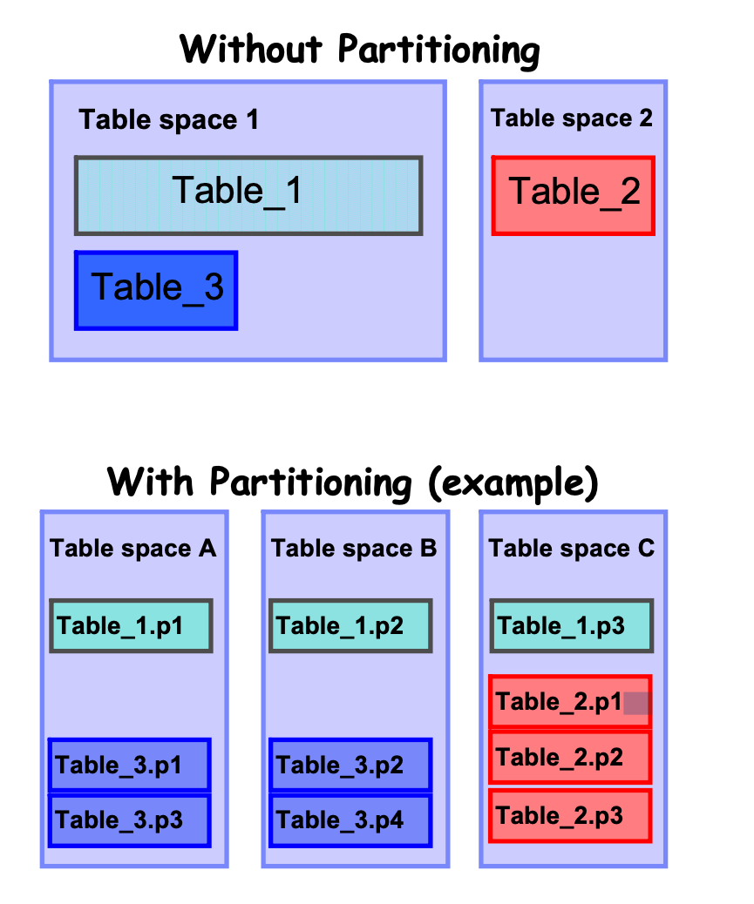
Benefits:
Can partition a single table across multiple table spaces (see diagram on the right)
SET INTEGRITY processing can be performed online
Flexible placement of large Indexes . May be defined using multiple table spaces
You have a data warehouse that would benefit from easier roll-in and roll-out of table data.
You have a data warehouse that includes large tables.
You want to use hierarchical storage management (HSM) solutions more effectively.
Table Partitioning - Benefits
© Copyright IBM Corporation 2009, 2020

Slide 8
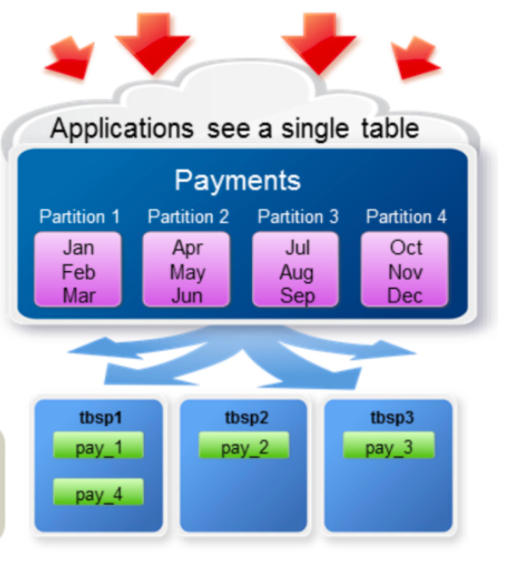
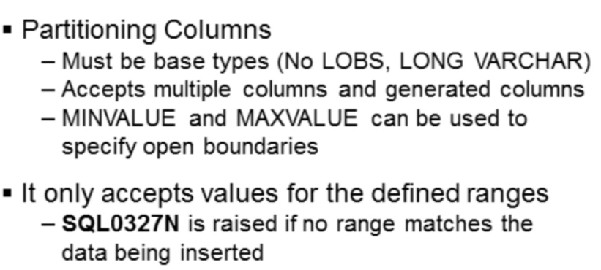
A table partitioning key is an ordered set of one or more columns in a table. The values in the table partitioning key columns are used to determine in which data partition each table row belongs.
To define the table partitioning key on a table use the CREATE TABLE statement with the PARTITION BY clause.
Choosing an effective table partitioning key column is essential to taking full advantage of the benefits of table partitioning.
Guidelines to choose the most effective table partitioning key columns for your partitioned table.
Define range granularity to match data roll-out. It is most common to use week, month, or quarter.
Define ranges to match the data roll-in size. It is most common to partition data on a date or time column.
Partition on a column that provides advantages in partition elimination.
Table Partitioning - Partitioning Keys
Short form
db2 "create table payments (id int , paydate date) in tbsp1 , tbsp2 , tbsp3 partition by range (paydate) (starting '01/01/2023' ending '12/31/2023' every 3 months)"
Long Form
db2 "create table payments1 (id int , paydate date) partition by range (paydate)
(partition pay1_23 starting '01/01/2023' in tbsp1,
partition pay2_23 starting '4/01/2023' in tbsp2,
partition pay3_23 starting '7/01/2023' in tbsp3,
partition pay4_23 starting '10/01/2023' ending '12/31/2023' in tbsp1)”
© Copyright IBM Corporation 2009, 2020

Slide 9

Table Partitioning - Creating Partition Table
Considerations
What tables benefit from being partitioned
Large tables
Roll-in/Roll-out
Business intelligence style queries
Which column(s) to partition on
Dates (roll-in)
Partition elimination
Granularity of ranges should match roll-in/roll-out
Consider placing different ranges in different tablespaces
Placement of indexes and LOBs
Type
Generally partition by range on dates
Common to partition on proxy columns for date
Granularity
Ranges match size of roll-out
Easy roll-out via DETACH
Typical roll-out policies of one month or one quarter yield manageable number of ranges
Less common for ranges sized to match roll-in
Many customers moving to very frequent roll-in (would be too many ranges to manage easily)
Normally partition on a single column
© Copyright IBM Corporation 2009, 2020

Slide 10
Table Partitioning - Creating Partition Table
Defining Ranges
Use STARTING … ENDING … to specify ranges……………
db2 "CREATE TABLE sales1(
customer_id BIGINT NOT NULL,
sale_date DATE NOT NULL )
PARTITION BY RANGE(sale_date NULLS LAST)
(
STARTING (MINVALUE) ENDING ('12/31/2022') ,
STARTING ('01/01/2023') ENDING ('3/31/2023') ,
STARTING ('04/01/2023') ENDING ('6/30/2023') ,
STARTING ('07/01/2023') ENDING ('9/30/2023') ,
STARTING ('10/01/2023') ENDING ('12/31/2023')
) "
Creates 4 ranges
Placement (data partition level) Each data partition can be placed individually
db2 "CREATE TABLE sales3
(sale_date DATE, customer INT)
PARTITION BY RANGE(sale_date)
(STARTING MINVALUE IN tbsp1 LONG IN large1,
STARTING ('01/01/2023') IN tbsp2 LONG IN large2,
STARTING ('04/01/2023') IN tbsp3 LONG IN large3,
STARTING ('07/01/2023') IN tbsp4 LONG IN large4,
STARTING ('10/01/2023')
ENDING ('12/31/2023') IN tbsp5 LONG IN large5)"
© Copyright IBM Corporation 2009, 2020

Slide 11
Table Partitioning - Creating Partition Table
The IN clause on CREATE TABLE accepts a list
Likewise for LONG IN
CREATE TABLE sales(sale_date DATE, customer INT, …)
IN tbsp1, tbsp2, tbsp3, tbsp4
LONG IN large1, large2, large3, large4
PARTITION BY RANGE(sale_date)
(STARTING (‘1/1/2022’) ENDING (’12/31/2024’) EVERY 3 MONTHS);
CREATE TABLE rotates through the lists in order
You can use table level and partition level placement together
db2 " CREATE TABLE sales6(sale_date DATE, customer BIGINT)
IN tbsp1, tbsp2
LONG IN large1, large2
PARTITION BY RANGE(sale_date)
(
STARTING MINVALUE IN tbsp0 LONG IN large0,
STARTING ('01/01/2023') ,
STARTING ('04/01/2023') ,
STARTING ('07/01/2023') ,
STARTING ('10/01/2023') ENDING ('12/31/2023') IN tbsp5 LONG IN large5
)”
SQL0327N: The row cannot be inserted because it is outside the bounds.
© Copyright IBM Corporation 2009, 2020

Slide 12
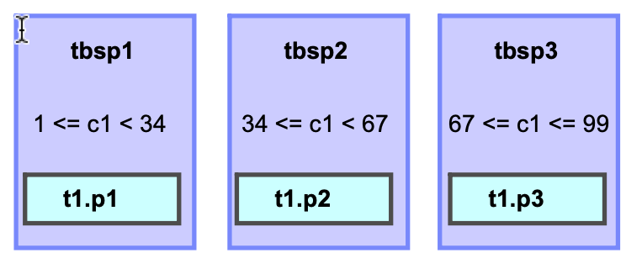
Table Partitioning - Creating Partition Table
Open Ended Range Use MINVALUE and MAXVALUE to specify open ended ranges
CREATE TABLE t1 ... (STARTING(MINVALUE) ENDING(MAXVALUE)
db2 "CREATE TABLE sales7(
customer_id BIGINT NOT NULL,
sale_date DATE NOT NULL )
PARTITION BY RANGE(sale_date NULLS LAST)
(
STARTING (MINVALUE) ENDING ('12/31/2022') ,
STARTING ('01/01/2023') ENDING ('3/31/2023') ,
STARTING ('04/01/2023') ENDING ('6/30/2023') ,
STARTING ('07/01/2023') ENDING ('9/30/2023') ,
STARTING ('10/01/2023') ENDING ('12/31/2023') ,
STARTING ('1/1/2024') ENDING (MAXVALUE)
) "
The first range holds everything before year 2006
Think of these as negative and positive infinity
Short and Long Forms
Short Form
CREATE TABLE t1(c1 INT, .........) IN tbsp1, tbsp2, tbsp3 PARTITION BY RANGE(c1)(STARTING FROM (1) ENDING (99) EVERY (33))
Long Form
CREATE TABLE t1(c1 INT, .........) PARTITION BY RANGE(c1) (STARTING FROM (1) ENDING(33) IN tbsp1, ENDING(66) IN tbsp2, ENDING(99) IN tbsp3)
© Copyright IBM Corporation 2009, 2020

Slide 13
Table Partitioning - Creating Partition Table
Multiple columns can be specified in the PARTITION BY clause
CREATE TABLE sales(year INT, month INT, …)
PARTITION BY RANGE(year, month)
(STARTING (2023, 1) ENDING (2023, 3),
STARTING (2023, 4) ENDING (2023, 6),
STARTING (2023, 7) ENDING (2023, 9),
STARTING (2023, 10) ENDING (2023, 12));
Naming Data Partitions - Named “q1”, “q2”, etc.
CREATE TABLE sales(sale_date DATE, customer INT, … ) PARTITION BY RANGE(sale_date) (PART rem STARTING MINVALUE ENDING '1/1/2006' EXCLUSIVE, PARTITION q1 STARTING '1/1/2023', PARTITION q2 STARTING '4/1/2023', PARTITION q3 STARTING '7/1/2023', PARTITION q4 STARTING '10/1/2023‘ ENDING ’12/31/2023');
© Copyright IBM Corporation 2009, 2020

Slide 14
Table Partitioning - Roll in
Alternatives for roll-in
in Predefine empty ranges for future use via LOAD, IMPORT, INSERT
Avoids lock and drain for ATTACH
Tradeoff is lower performance and more contention during roll-in
Reasonable choice if data trickles in continuously
Granularity should then match either roll-out, or partition elimination
ADD + LOAD
Recommend against this
Access to table disrupted twice: once for ADD, once for LOAD
ADD will lock table, drain packages
Entire table is read-only during LOAD
Constraints or MQTs + LOAD => “no data movement”
© Copyright IBM Corporation 2009, 2020

Slide 15
Table Partitioning - Roll In
Authority For Attach
For the target table:
ALTER + INSERT
For the source table, one of the following:
SELECT (table) and DROPIN (schema), or …
CONTROL privilege, or …
SYSADM or DBADM authority
The following conditions must be met before you can attach a data partition:
The target table must be an existing partitioned table.
The source table must be an existing nonpartitioned table or a partitioned table.
To attach multiple data partitions, you must issue multiple ATTACH statements.
The source table cannot be a typed table.
The source table cannot be a range-clustered table.
The source and target table definitions must match.
The number, type, and ordering of source and target columns must match.
Source and target table columns must match in terms of whether they contain default values.
Source and target table columns must match in terms of whether they allow null values.
Source and target table compression specifications, including the VALUE COMPRESSION and COMPRESS SYSTEM DEFAULT clauses, must match.
Source and target table specifications for the DATA CAPTURE, ACTIVATE NOT LOGGED INITIALLY, and APPEND options must match.
Attaching a data partition is allowed even when a target column is a generated column and the corresponding source column is not a generated column.
© Copyright IBM Corporation 2009, 2020

Slide 16
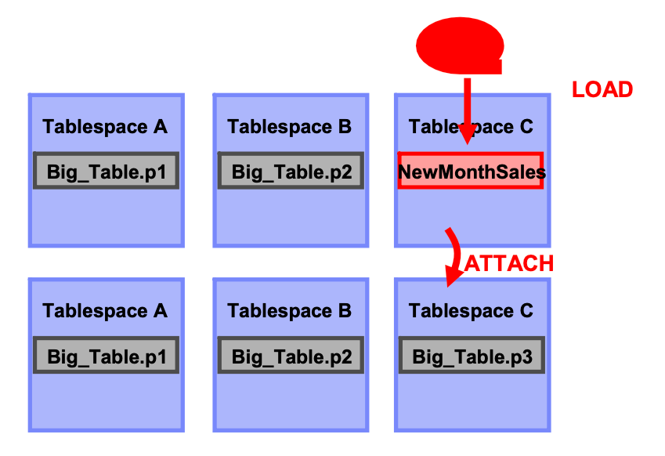
Table Partitioning - Roll In
Rollin Overview
• LOAD / Insert into NewMonthSales
• (Perform ETL on NewMonthSales)
ALTER TABLE Big_Table …
ATTACH PARTITION ... STARTING '03/01/2013' ENDING '03/31/2013' FROM TABLE NewMonthSales
– Very fast operation
– No data movement required
– Index maintenance deferred
• COMMIT
– New datas till not visible
• SET INTEGRITY FOR Big_Table ......
– Potentially long running operation:
• Validates data
• Maintains Non-partitioned indexes, MQTs
– Existing data available while it runs
• COMMIT
– New data visible
© Copyright IBM Corporation 2009, 2020

Slide 17
Table Partitioning - Roll Out
Authority Required for DETACH PARTITION
User must have ALTER, to SELECT from and to DELETE from the source table.
The user must also have the authority necessary to create the target table. The following authorities or privileges on the target table:
DBADM authority
CREATETAB authority on the database and USE privilege on the table spaces
IMPLICIT_SCHEMA authority on the database
CREATEIN privilege on the schema
© Copyright IBM Corporation 2009, 2020

Slide 18
Table Partitioning - Roll Out
You must meet the following conditions before you can perform a DETACH PARTITION operation:
The table to be detached from (source table) must exist and be a partitioned table.
The data partition to be detached must exist in the source table.
The source table must have more than one data partition. A partitioned table must have at least one data partition. Only visible and attached data partitions pertain in this context. An attached data partition is a data partition that is attached but not yet validated by the SET INTEGRITY statement.
The name of the table to be created by the DETACH PARTITION operation (target table) must not exist.
DETACH PARTITION is not allowed on a table that is the parent of an enforced referential integrity (RI) relationship. If you have tables with an enforced RI relationship and want to detach a data partition from the parent table, a workaround is available. In the following example, all statements are run within the same unit of work (UOW) to lock out concurrent updates:
The SET INTEGRITY statement is required to be run on the detached dependent tables to incrementally maintain the tables.
The detach process is initiated when an ALTER TABLE...DETACH PARTITION statement is issued:
The ALTER TABLE...DETACH PARTITION operation logically detaches the data partition from the partitioned table.
An asynchronous partition detach task converts the logically detached partition into the stand-alone table.
© Copyright IBM Corporation 2009, 2020

Slide 19
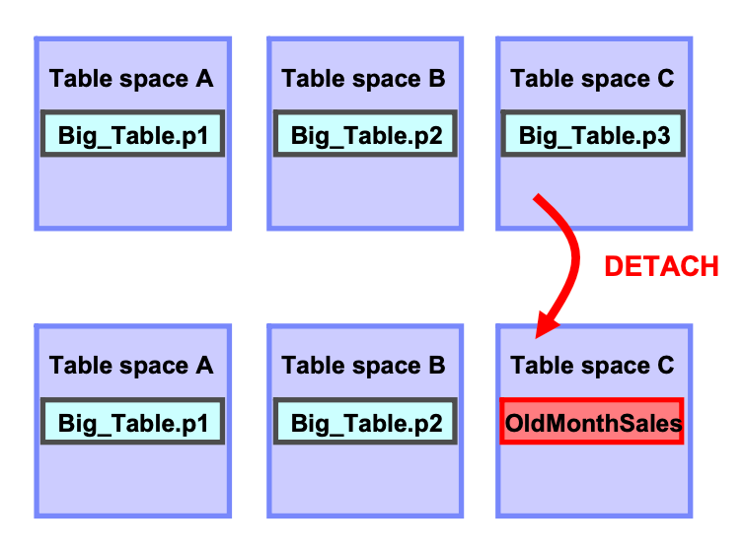
Table Partitioning - Roll Out
Rollout Overview
ALTER TABLE Big_Table DETACH PARTITION p3 INTO TABLE OldMonthSales
– Very fast operation
– No data movement required
– Index maintenance for non-partitioned indexes performed asynchronously in background
The ALTER TABLE...DETACH PARTITION operation performs in the following manner:
Does not wait for dynamic uncommitted read (UR) isolation level queries before it proceeds, nor does it interrupt any currently running dynamic UR queries. This behavior occurs even when the UR query is accessing the partition being detached.
If dynamic non-UR queries (read or write queries) did not lock the partition to be detached, the DETACH operation can complete while dynamic non-UR queries are running against the table.
If dynamic non-UR queries locked the partition to be detached, the DETACH operation waits for the lock to be released.
Hard invalidation must occur on all static packages that are dependent on the table before the DETACH operation can proceed.
The following restrictions that apply to data definition language (DDL) statements also apply to a DETACH operation because DETACH requires catalogs to be updated:
New queries cannot be compiled against the table.
A bind or rebind cannot be performed on queries that run against the table.
To minimize the impact of these restrictions, issue a COMMIT immediately after a DETACH operation.
© Copyright IBM Corporation 2009, 2020

Slide 20
Table Partitioning - Roll Out
Rollout Overview
Rolled-out data can be dropped, archived, moved to HSM
Queries are drained and table locked by DETACH
Dependent “refresh immediate” MQTs go offline and need to be refreshed via SET INTEGRITY
Run RUNSTATS after the completion of the DETACH PARTITION operation on both the new detached table and the source table, because many of the statistics will not be carried over following the completion of the detach partition operation.
Rolled-out data is available in a new, separate table
Data disappears from view immediately upon DETACH
Delete triggers do not fire for DETACH
Asynchronous partition detach task
After the DETACH operation commits and any detached dependent tables are refreshed, the asynchronous partition detach task converts the logically detached partition into the stand-alone table.
The asynchronous partition detach task waits for the completion of all access on the partitioned table that started before phase 1 of the detach operation.
If the partitioned table has nonpartitioned indexes, the asynchronous partition detach task creates the asynchronous index cleanup task for deferred indexed cleanup.
After the access completes, the asynchronous partition detach task completes phase 2 of the detached operation, by converting the logically detached partition into a stand-alone table.
© Copyright IBM Corporation 2009, 2020

Slide 21
Table Partitioning - Roll Out
Asynchronous Index Cleanup
Asynchronous index cleanup (AIC) is the deferred cleanup of indexes following operations that invalidate index entries.
Invalid index entries are removed by index cleaners, which operate asynchronously in the background.
AIC is a new feature to cleanup indexes
Low priority background process
Reclaims space in index (keys corresponding to data rolled-out)
Automatically started when DETACH is committed (or after refresh of dependent MQTs)
Pauses if would have gotten lock conflict with user activity
Will NOT keep database active
Cannot ADD/ATTACH another partition with the same name until AIC has completed cleaning up indexes from the detached partition.
$ db2 list utilities show detail
ID = 11
Type = ASYNCHRONOUS INDEX CLEANUP
Database Name = TEST
Partition Number = 0
Description = Table: KBECK .PART_TAB, Index: KBECK .IX02
Start Time = 05/10/2006 09:48:40.248723
State = Executing
Invocation Type = Automatic
Throttling:
Priority = 50
Progress Monitoring:
Total Work = 6669 pages
Completed Work = 72 pages
Start Time = 05/10/2006 09:48:40.264229
© Copyright IBM Corporation 2009, 2020

Slide 22
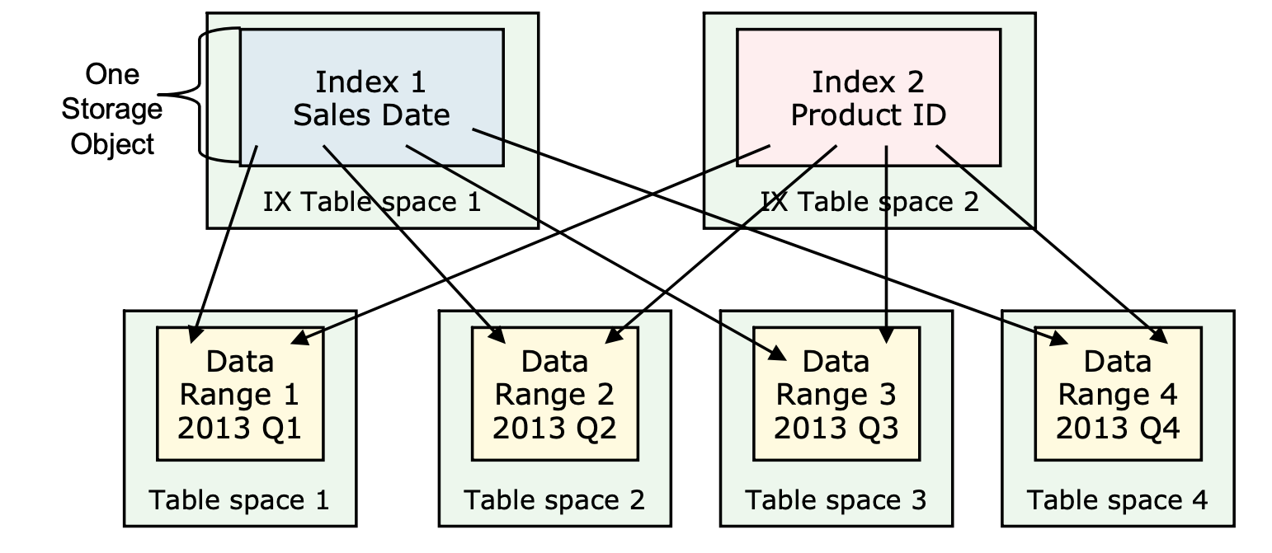
Table Partitioning - Index
Nonpartitioned Index
A nonpartitioned index is a single index object that refers to all rows in a partitioned table
CREATE INDEX Order_shipment ON ORDERS(order_shipment) NOT PARTITIONED;
There are some types of indexes that cannot be partitioned:
Indexes over nonpartitioned data
Indexes over spatial data
XML column path indexes (system generated)
– Each index contains entries of every row in the range-partitioned table
– Each index is managed as a separate storage object
– CREATE INDEX IN tsname can be used to override location for new indexes
© Copyright IBM Corporation 2023

Slide 23
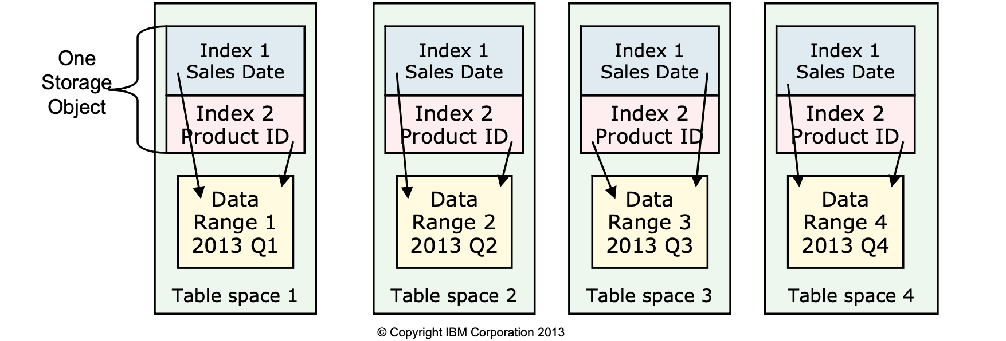
Table Partitioning - Index
Partitioned indexes:
– A unique partitioned index must contain the columns used in the PARTITION BY RANGE clause
– Each index contains one index partition for each data range in the range-partitioned table
– All partitioned indexes are managed as a single storage object per data range
– CREATE INDEX IN tsname can NOT be used to override the index location
– The INDEX IN clause of CREATE TABLE can be specified for a single data range
– INDEX IN clause can be specified for ALTER TABLE ADD PARTITION

Slide 24
Table Partitioning - Performance
Partition Elimination (Table Scan)
select * from tab1 where a>32 and a<54
scan
a >= 0
a < 20
a >= 21
a < 40
a >= 41
a < 60
a >= 61
a < 80
© Copyright IBM Corporation 2009, 2020

Slide 25
Table Partitioning - Performance
Utility support for partitioned tables
• REORG TABLE:
– By default All Partitions reorganized serially
– No INPLACE reorgs, OFFLINE reorg with ALLOW READ ACCESS allowed
– The ON DATAPARTITION clause can be used to reorg one data partition
• If only Partitioned indexes are defined other partitions may have full read/write
Multiple concurrent partition level reorgs are allowed
• REORG INDEX:
– Individual Non-partitioned Indexes can be reorganized
– No ALLOW WRITE ACCESS allowed
– The ON DATAPARTITION clause can be used to reorg the partitioned indexes for one data partition
• RUNSTATS:
– Statistics are collected forALL partitions
– Can use TABLESAMPLE to reduce I/O and CPU costs
• ROLLFORWARD to Point In Time
– Requires that all table spaces sharing pieces of a table be rolledforward together
• LOAD:
– Supports Partitioned table as target
– Can not limit Load to selected partition(s), limited access during load
– Supports all INDEXING modes :REBUILD,INCREMENTAL,DEFERRED
© Copyright IBM Corporation 2009, 2020

Slide 26
Advantages
Table Partitioning
Advantages of table partitioning for roll-in
Minimal disruption Table is offline for only a few seconds during ATTACH
Data appears all at once In contrast to IMPORT, where data trickles in
Works well with MQTs, constraints, generated columns
Disadvantages
Total time for roll-in much longer than Union All Views
ATTACH is only useful if roll-in granularity matches range boundaries
© Copyright IBM Corporation 2009, 2020

Slide 27
Useful Queries Related to SET INTEGRITY
Table Partitioning
All tables in the database that are in SET INTEGRITY PENDING (SIP) state
SELECT TABLES.TABSCHEMA, TABLES.TABNAME FROM SYSCAT.TABLES TABLES WHERE STATUS='C';
Tables with detached attribute set
After DETACH, target table is inaccessible until MQTs are refreshed
There is a new catalog view for this SYSCAT.TABDETACHEDDEP
After ATTACH or DETACH, you need to run SET INTEGRITY on all dependent REFRESH IMMEDIATE MQTs WITH DEP_CNT(TOTAL_DEP) AS (SELECT COUNT(*) FROM SYSCAT.TABDEP), DEP_TAB(SCHEMA, NAME, TYPE, REFRESH, LEVEL) AS (SELECT TABLES.TABSCHEMA, TABLES.TABNAME, TABLES.TYPE, TABLES.REFRESH, 0 FROM SYSCAT.TABLES TABLES WHERE TABLES.TABSCHEMA='<schema name>' AND TABLES.TABNAME='<table name>‘ UNION ALL SELECT TABDEP.TABSCHEMA, TABDEP.TABNAME, TABDEP.DTYPE, TABLES.REFRESH, DEP_TAB.LEVEL + 1 FROM SYSCAT.TABDEP TABDEP, DEP_TAB, SYSCAT.TABLES TABLES WHERE TABDEP.DTYPE IN ('S', 'V', 'W', 'T') AND TABDEP.BSCHEMA = DEP_TAB.SCHEMA AND TABDEP.BNAME = DEP_TAB.NAME AND TABLES.TABSCHEMA = TABDEP.TABSCHEMA AND TABLES.TABNAME = TABDEP.TABNAME AND DEP_TAB.LEVEL < (SELECT DEP_CNT.TOTAL_DEP FROM DEP_CNT)) SELECT DISTINCT * FROM (SELECT DEP_TAB.SCHEMA, DEP_TAB.NAME FROM DEP_TAB WHERE DEP_TAB.TYPE = 'S' AND DEP_TAB.REFRESH = 'I‘
© Copyright IBM Corporation 2009, 2020

Slide 28
Table Partitioning
Q & A
© Copyright IBM Corporation 2009, 2020

